Slide 1
SSVEPs & reward
Summary of the results

Slide 2
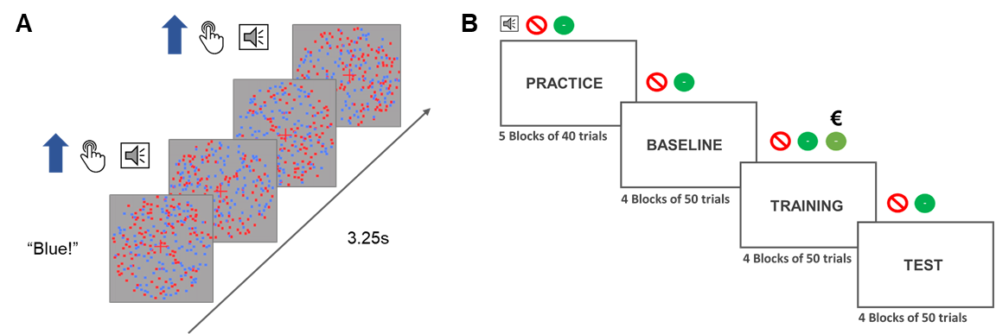
Paradigm

Slide 3
Paradigm
Dots in two colors (125/125)
Flickering at 10 & 12Hz
Random motions
Trials last for 3.25s
390 frames at 120Hz
In each phase: 75% of dots move coherently 240 times over 200 trials
Trials: no coherent motion (40%), one, two, or three
Three phases (baseline, training, test) with 200 trials in each
To-be-attended color is cued by a sound at the beginning of each trial (“blue” or “red”)
Participants need to detect the coherent motion (press SPACE)
Auditory feedback:
Wrong
Missed motion
Correct

Slide 4
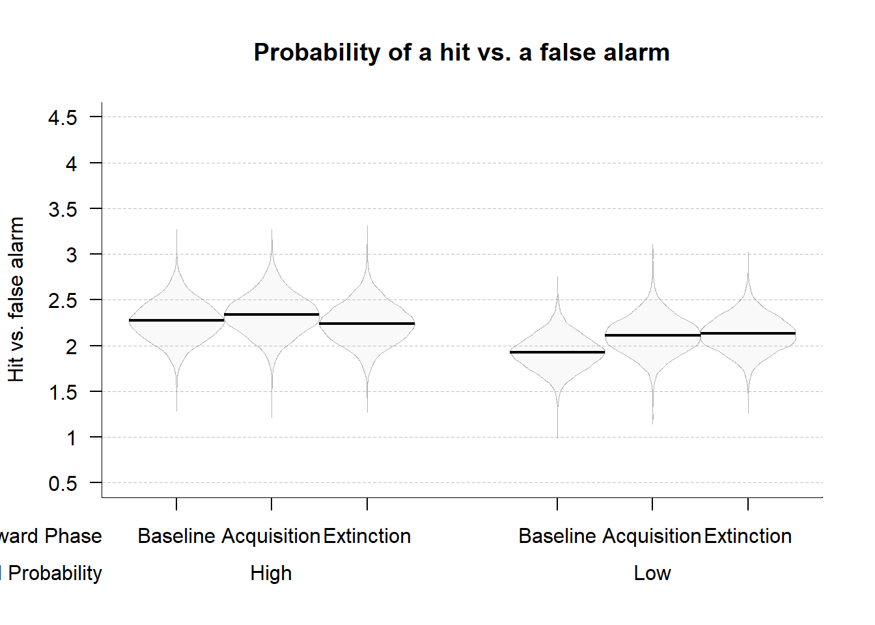
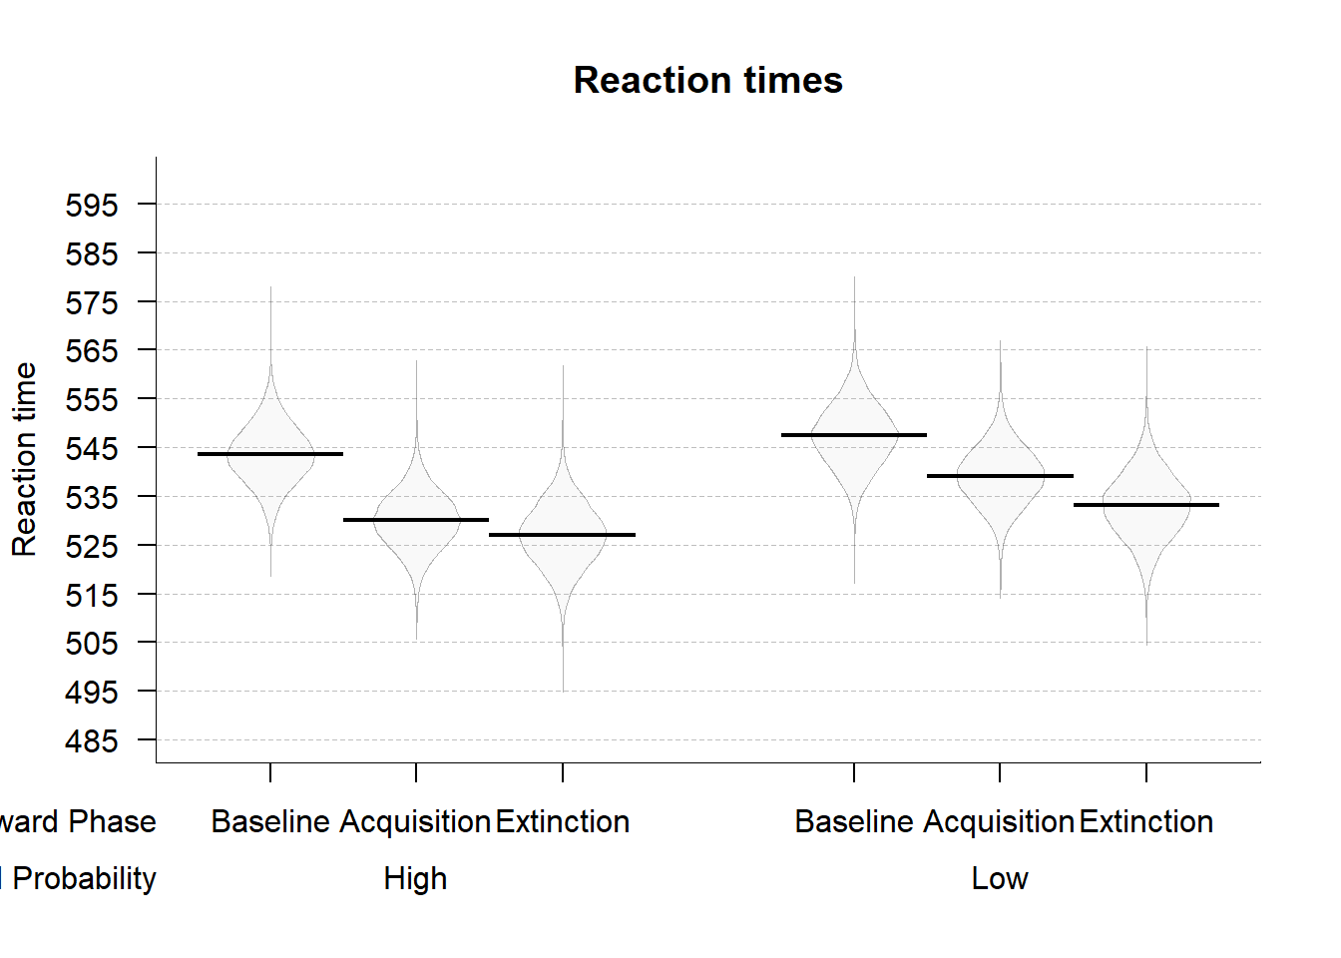
Behavior – only movement trials

Slide 5
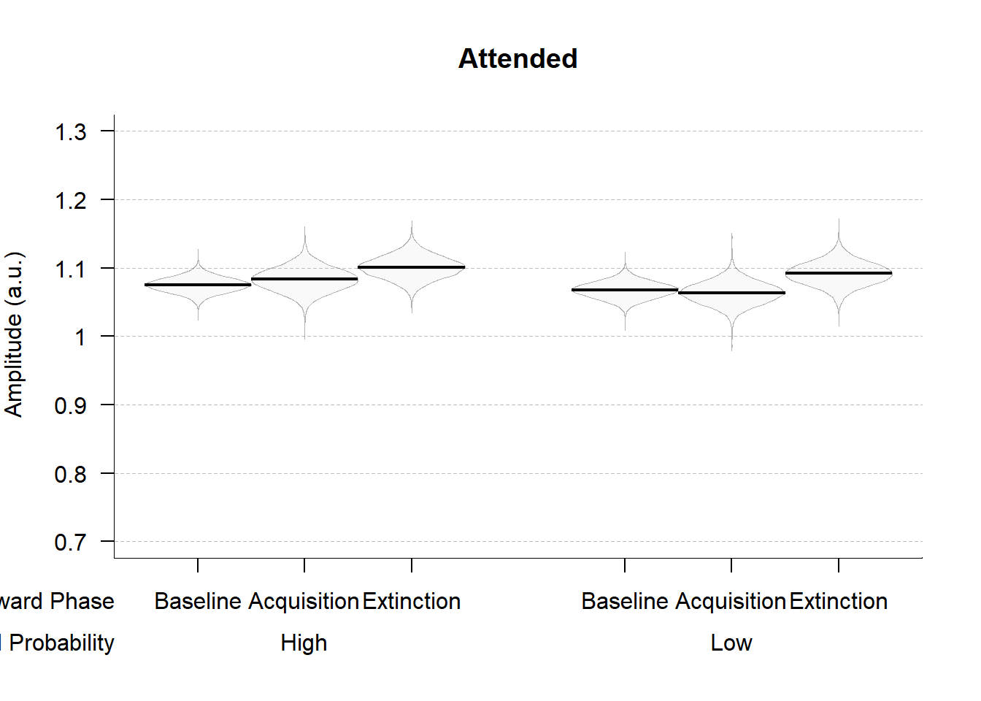
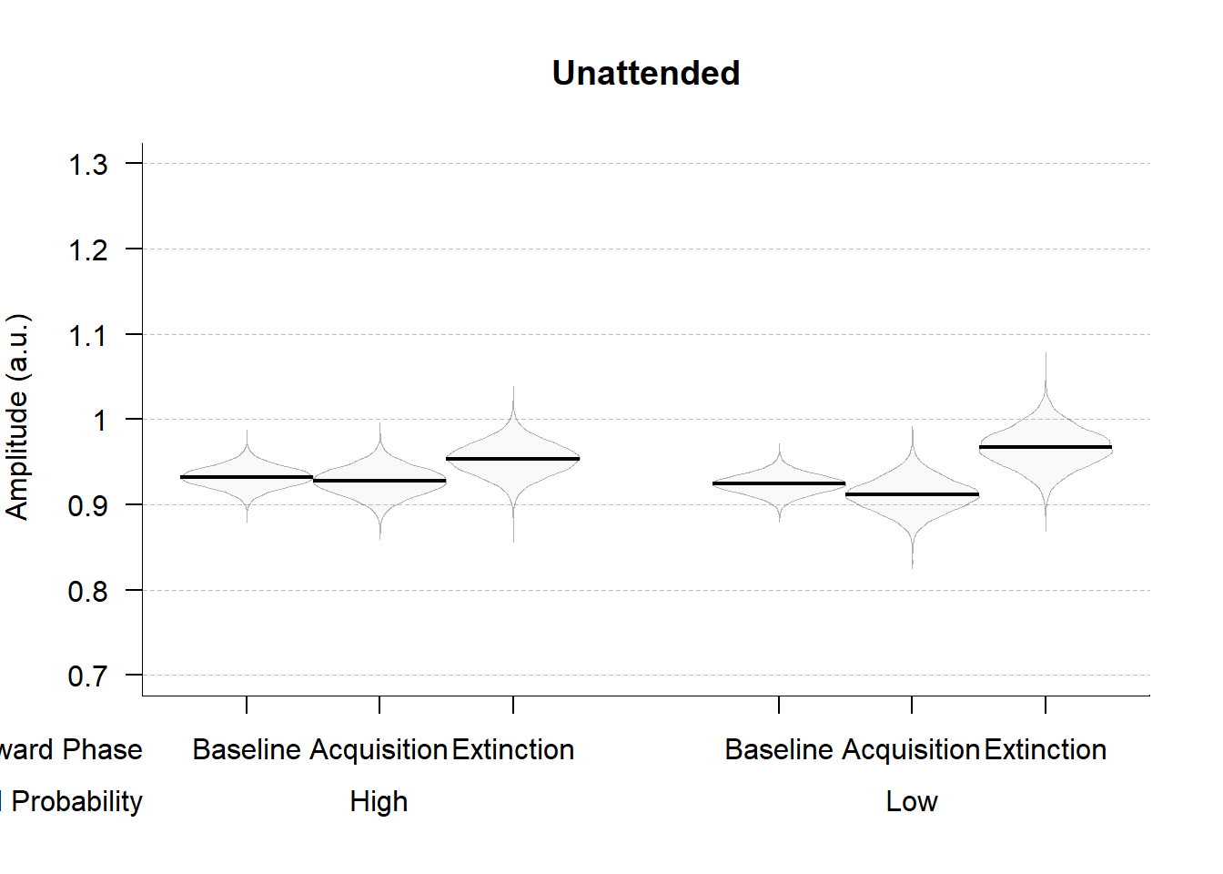
SSVEPs – all trials (movement and no movement)

Slide 6
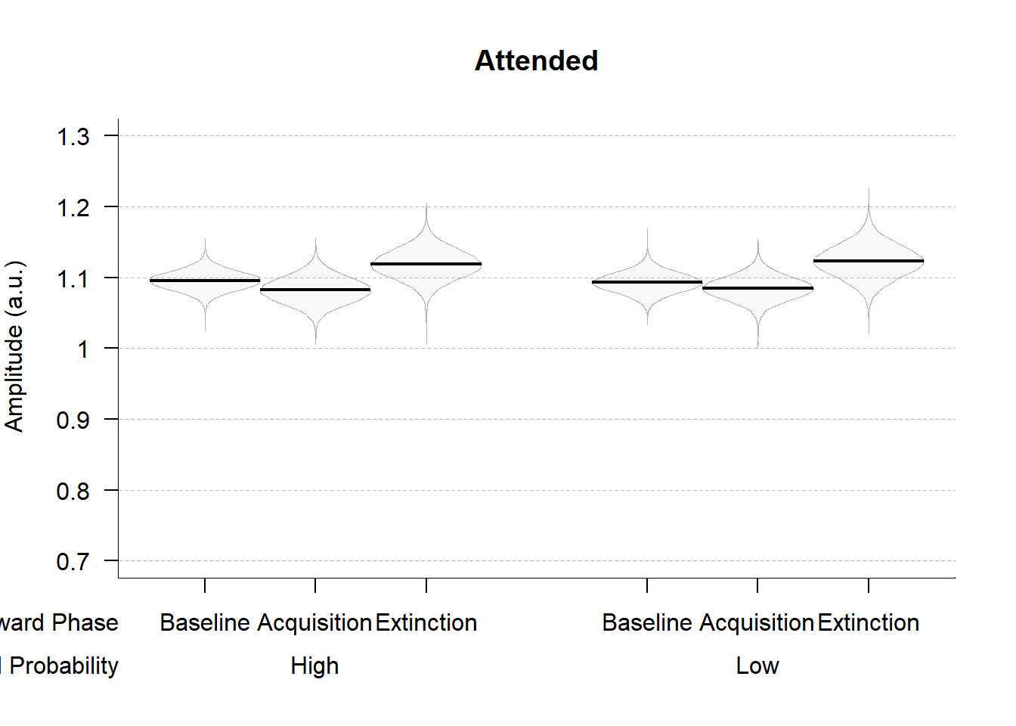
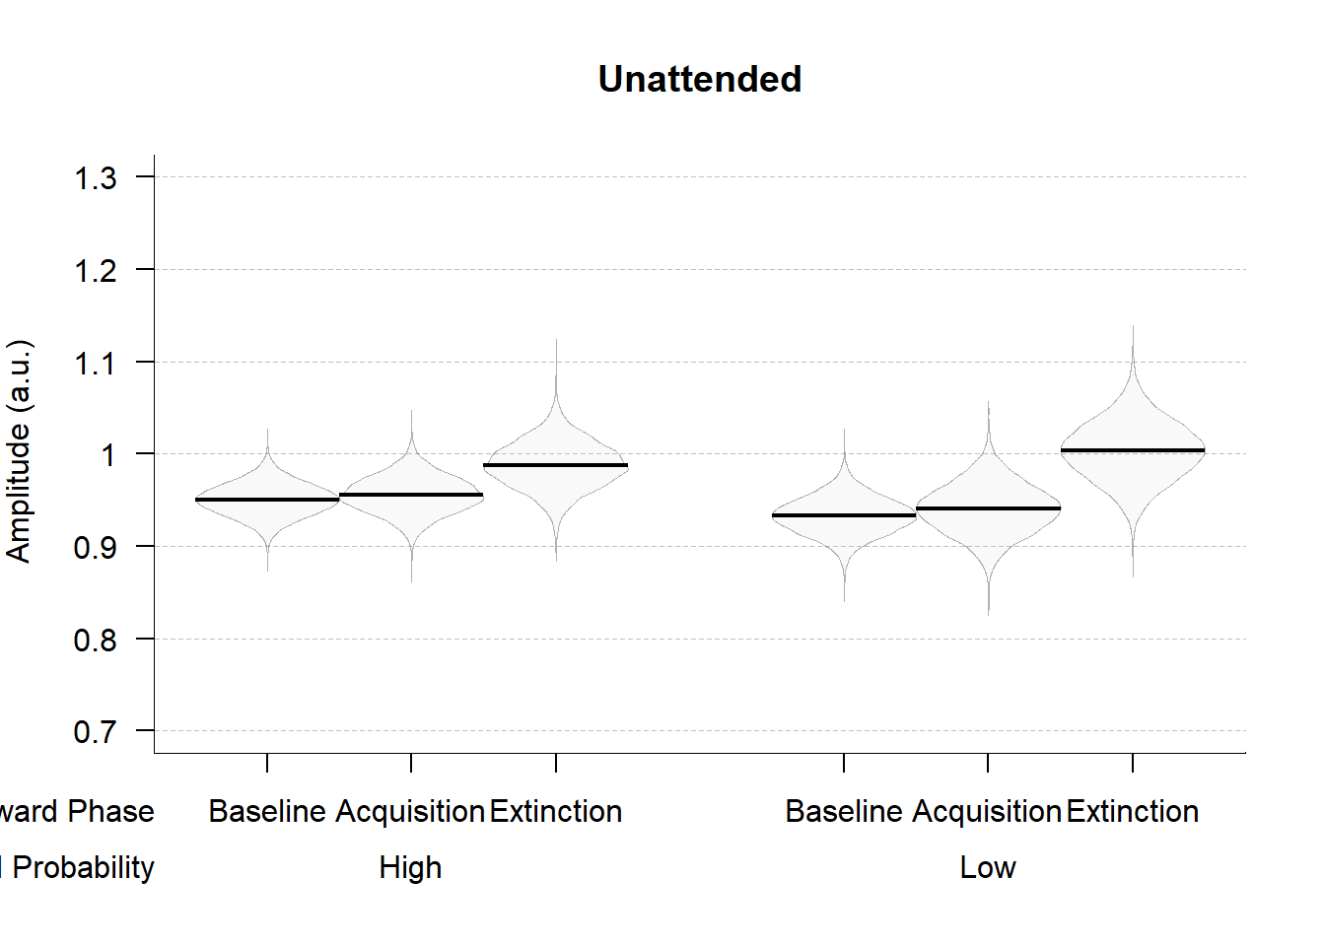
SSVEPs – no movement trials

Slide 7

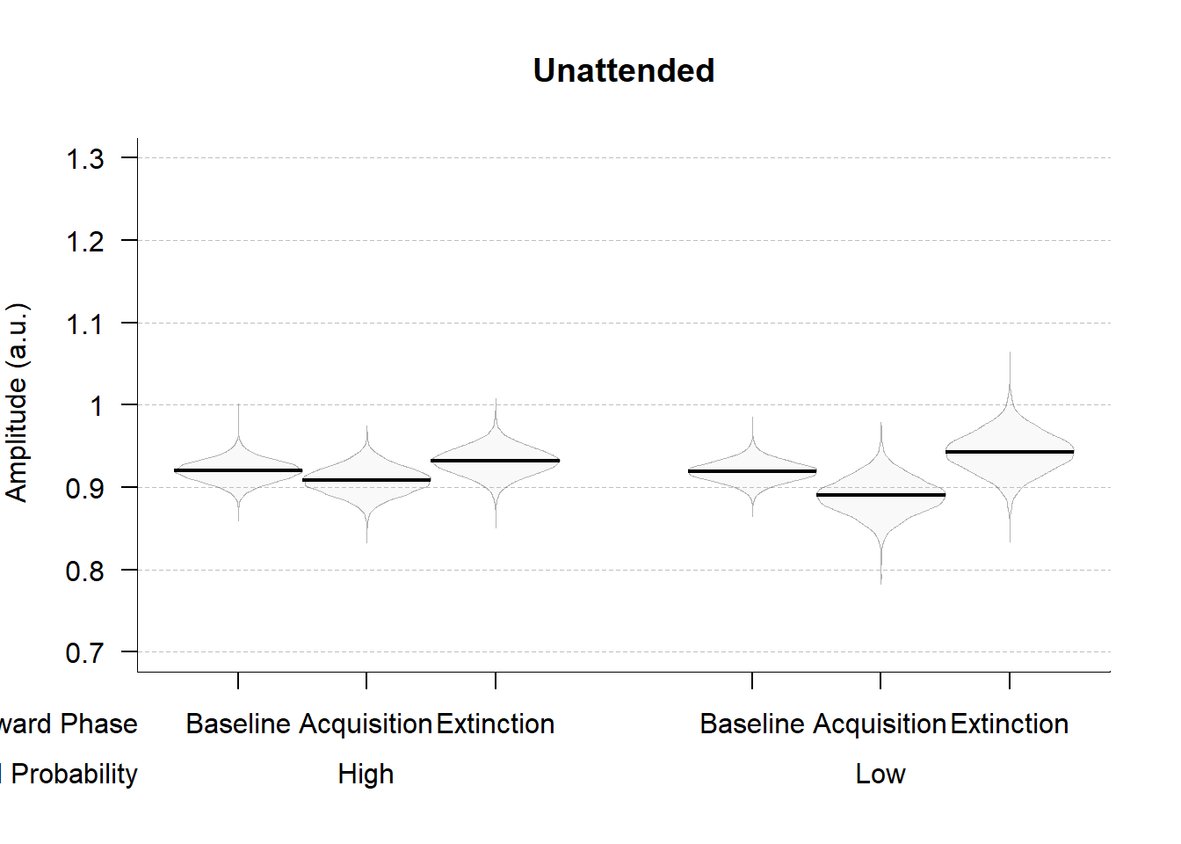
SSVEPs – movement trials

